Slide 1
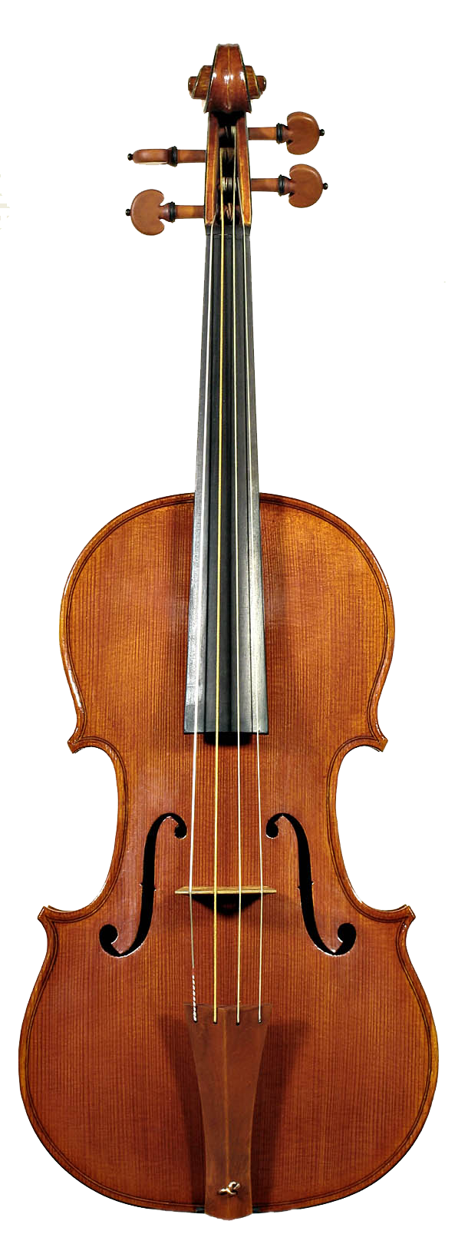
Vibrato

Slide 2

Vibrato simulation
Small, quasi-periodic variations in pitch of tone
Typical vibrato depth is on order of 1 percent
One semitone = variation
Often accompanied by tremolo
Amplitude modulation at same frequency as vibrato
To apply vibrato
Quasi-periodic frequency shift
Use a modulated delay line
Time-varying delay changes pitch of sound
Simulated Doppler shift

Slide 3
Vibrato in the acoustic world
Violin
Vibrato produced by wiggling finger
Changes where the string is stopped on the fingerboard
Vibrato frequency can be very slow
circa 6 Hz for example
Frequency modulations of string vibrations produce amplitude modulations
Due to complex frequency response of violin body
Singing voice
Vibrato produced by modulating tension of vocal folds

Slide 4

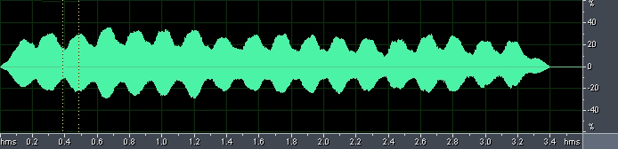
Examples
Single note (A#) with no vibrato
Same note, with vibrato
Without vibrato, with reverb
Vibrato and reverb

Slide 5


Digital implementation
Variable delay alone, no mix
Delay modulation yields vibrato when the modulation is sinusoidal
Reduced case of the flanger
Variation controlled by low-frequency oscillator
Interpolated (fractional) delay line is required
Typical values
M (average delay): 5-10ms
f = (LFO frequency): 5-14Hz
Basic vibrato
LFO
x[n]
y[n]
Delay M[N]
Modulated delay and pitch shift

Slide 6
Effect of changing delay
How do frequencies in a signal change with a changing delay?
Suppose the delay is constant
So output samples are still one sampling period apart
Suppose delay always increasing
Output samples are 0.9 times the sampling period apart
Less samples (so less time) for one cycle of a sinusoid.
So increasing delay gives longer period / lower frequency / pitch shift down
… Decreasing delay gives shorter period / higher frequency / pitch shift up
Generalises to pitch shift given by
For
Now consider vibrato

Slide 7


Determining vibrato width
Width (max frequency deviation) of vibrato depends on LFO frequency and sweep width:
Consider average delay M, sweep width W, frequency f
Total delay
Derivative of delay is difference in speed between read and write pointers:
Like difference
Write pointer always moves at constant speed
1 sample written per input sample
Speed of the read pointer determines pitch shift:
Example for one semitone vibrato (1.059), f = 5Hz:

Slide 8
Vibrato in operation. LFO waveform and pitch shift
W=2ms, M=2ms, f_{LFO}= 2 Hz
W=2ms, M=2ms, f_{LFO}= 4 Hz
LFO waveform
Pitch shift

Slide 9
Three commonly used low frequency oscillator (LFO) waveforms

Slide 10



Other LFO waveforms
Sinusoidal LFO modulation is the most common
Resembles vibrato in the physical/acoustic world
What if we used a triangle wave LFO?
1.0

Slide 11
Triangular and sawtooth LFOs, with corresponding pitch shift

Slide 12
Vibrato C++ code(1/2)
// Variables in this example whose values are set externally:
int numSamples; // Indicates how many audio samples to process
float *channelData; // Array of audio samples, length numSamples
float *delayData; // Our circular delay buffer of audio samples
int BufLength; // Length of our delay buffer in samples
int dpw; // Write pointer into the delay buffer
float ph; // Current phase of the LFO, always between 0-1
float inverseSampleRate; // 1/f_s, where f_s is sampling frequency
// User-adjustable effect parameters:
float frequency_; // Frequency of the low-frequency oscillator
float sweepWidth_; // Width of the LFO in samples

Slide 13
Vibrato C++ code(2/2)
for (i = 0; i < numSamples; ++i)
{
in = channelData[i];
// Recalculate read pointer position with respect to write pointer.
currentDelay = sweepWidth_*(1 + sinf(2 * M_PI * ph))/2;
//Subtract 3 samples to delay pointer so enough written samples to interpolate
dpr= fmodf(dpw-currentDelay*getSampleRate())+BufLength-3, BufLength);
// Interpolate fractional value from where read pointer sits between two samples
fraction = dpr - floorf(dpr);
prevSample = (int)floorf(dpr);
nextSample = (prevSample + 1) % BufLength;
interpSample=fraction*delayData[nextSample]+(1-fraction)*delayData[prevSample];
delayData[dpw] = in; // Store current information in delay buffer
//Increment write pointer at constant rate. Read pointer moves at different
// rates depending on settings of LFO, the delay and sweep width.
if (++dpw >= BufLength) dpw = 0;
// Store output sample in buffer, replacing input. Delayed sample is only
//component of output (no mixing with dry signal)
channelData[i] = interpSample;
ph += frequency_*inverseSampleRate; // Update LFO phase, keeping it in range 0-1
if(ph >= 1.0) ph -= 1.0;
}

Slide 14
Vibrato code
Our Delay effect will be simple VST plugin
Start with Delay plugin
Add methods for LFO and interpolation
In processBlock
Outer loop is samples, inner loop is channels
→ So only increment pointer once for each sample

Slide 15
Define and initialise
Start with Delay plugin
Change private parameters to pluginProcessor.h
float getLfoSample(float phase, int waveform);
float interpolateSample(int type, float delayReadPosition,
float* delayData, int delayBufferLength);
void parameterChanged();
juce::AudioParameterFloat* lfoFrequencyParam;
juce::AudioParameterFloat* sweepWidthParam;
juce::AudioParameterChoice* lfoTypeParam;
juce::AudioParameterChoice* interpolationTypeParam;
float lfoPhase; // Phase of the low-frequency oscillator
juce::AudioSampleBuffer delayBuffer;
int delayBufferLength;
int delayReadPosition, delayWritePosition = 0;
Parameters on interface
Circular buffer variables for implementing delay
Notes:
MidiKeyboardComponent needs a MidiKeyboardState and the orientation as arguments.

Slide 16
Define and initialise
Set up delay buffer in prepareToPlay on pluginProcessor.cpp
Allocate and zero the delay buffersize will depend on current sample rate)
Add 3 extra samples to allow cubic interpolation even at maximum delay
void NewProjectAudioProcessor::prepareToPlay (double sampleRate, int samplesPerBlock)
{
float sweepWidthMax = sweepWidthParam->getNormalisableRange().end;
delayBufferLength = (int)(sweepWidthMax * sampleRate) + 3;
delayBuffer.setSize(2, delayBufferLength);
delayBuffer.clear();
lfoPhase = 0.0f;
}
Notes:
MidiKeyboardComponent needs a MidiKeyboardState and the orientation as arguments.

Slide 17
The LFO
Information about these samples
Set up the basics in the processBlock method on pluginProcessor.cpp
const int numInputChannels = getTotalNumInputChannels();
const int numOutputChannels = getTotalNumOutputChannels();
const int numSamples = buffer.getNumSamples();
float sampleRate = (float)juce::AudioProcessor::getSampleRate();
auto dryWetMix = dryWetMixParam->get();
auto feedback = feedbackParam->get();
auto delayTime = delayTimeParam->get();
int channel, dpr, dpw; // dpr = delay read pointer; dpw = delay write pointer
delayReadPosition = (int)(delayWritePosition - (delayTime * getSampleRate())
+ delayBufferLength) % delayBufferLength;
Notes:
must pass MidiKeyboardState object to initialise MidiKeyboardComponent object

Slide 18
Get LFO sample
Function for calculating ‘biased’ LFO waveforms with output range [0, 1]
Phase range [0, 1], output also [0, 1]
not [-1, +1] as for ordinary Sine function
float VibratoAudioProcessor::getLfoSample(float phase, int waveform) {
switch (waveform) {
case 0://Triangle:
if (phase < 0.25f) return 0.5f + 2.0f*phase;
else if (phase < 0.75f) return 1.0f - 2.0f*(phase - 0.25f);
else return 2.0f*(phase - 0.75f);
case 1://Sawtooth:
if (phase < 0.5f) return 0.5f + phase;
else return phase - 0.5f;
case 2://InverseSawtooth:
if (phase < 0.5f) return 0.5f - phase;
else return 1.5f - phase;
case 3://Sine:
return 0.5f + 0.5f*sinf(juce::MathConstants<float>::twoPi * phase);
}
}
Notes:
must pass MidiKeyboardState object to initialise MidiKeyboardComponent object

Slide 19
Interpolate sample
Round to nearest integer. If it rounds to end of buffer, roll back to beginning
float NewProjectAudioProcessor::interpolateSample(int type,
float delayReadPosition, float* delayData, int delayBufferLength) {
switch (type) {
case 0: { //NearestNeighbour:
int closestSampleIndex = (int)floorf(delayReadPosition + 0.5f);
if (closestSampleIndex == delayBufferLength) closestSampleIndex = 0;
return delayData[closestSampleIndex];
}
…
}
}
Notes:
must pass MidiKeyboardState object to initialise MidiKeyboardComponent object

Slide 20
Interpolate sample
adjust sample weights with fraction by which read pointer between 2 samples
float NewProjectAudioProcessor::interpolateSample(int type,
float delayReadPosition, float* delayData, int delayBufferLength) {
switch (type) {
…
case 1: { // linear
float fraction = delayReadPosition - floorf(delayReadPosition);
int sample0 = (int)floorf(delayReadPosition);
int sample1 = (sample0 + 1) % delayBufferLength;
return fraction * delayData[sample1]
+ (1.0f - fraction) * delayData[sample0];
}
…
}
}
Notes:
must pass MidiKeyboardState object to initialise MidiKeyboardComponent object

Slide 21
Interpolate sample
adjust sample weights with fraction by which read pointer between 3 samples
float NewProjectAudioProcessor::interpolateSample(int type,
float delayReadPosition, float* delayData, int delayBufferLength) {
switch (type) {
…
case 2: { //quadratic
int sample1 = (int)floorf(delayReadPosition + 0.5) % delayBufferLength;
int sample2 = (sample1 + 1) % delayBufferLength;
int sample0 = (sample1 - 1) % delayBufferLength;
float fraction = delayReadPosition - sample1;
return (fraction * (fraction - 1) * delayData[sample0]
- 2 * (fraction - 1) * (fraction + 1) * delayData[sample1]
+ fraction * (fraction + 1) * delayData[sample2]) / 2.0f;
}
}
}
Notes:
must pass MidiKeyboardState object to initialise MidiKeyboardComponent object

